Slide 1
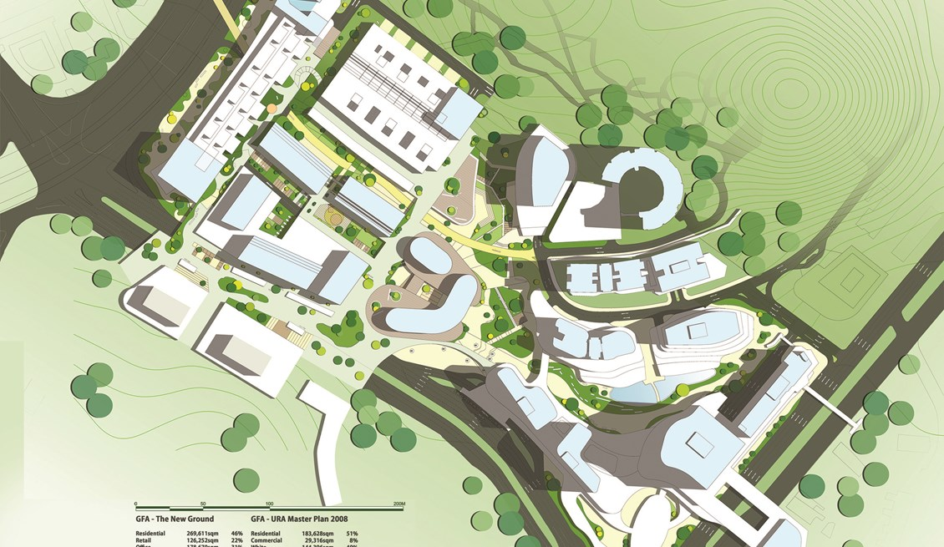

Login to Middlechase
Email
Password
LOG IN
Register | Forgot Password

Slide 2
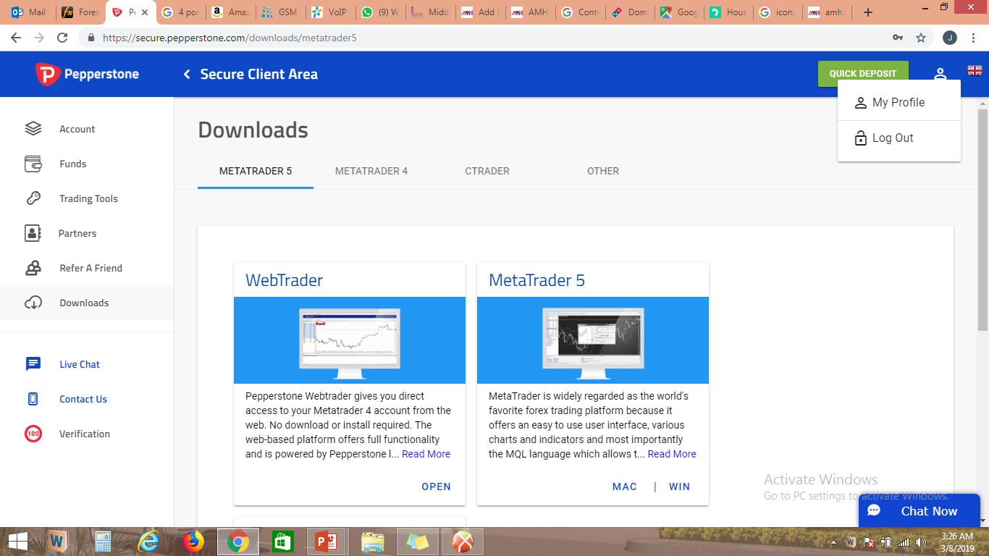
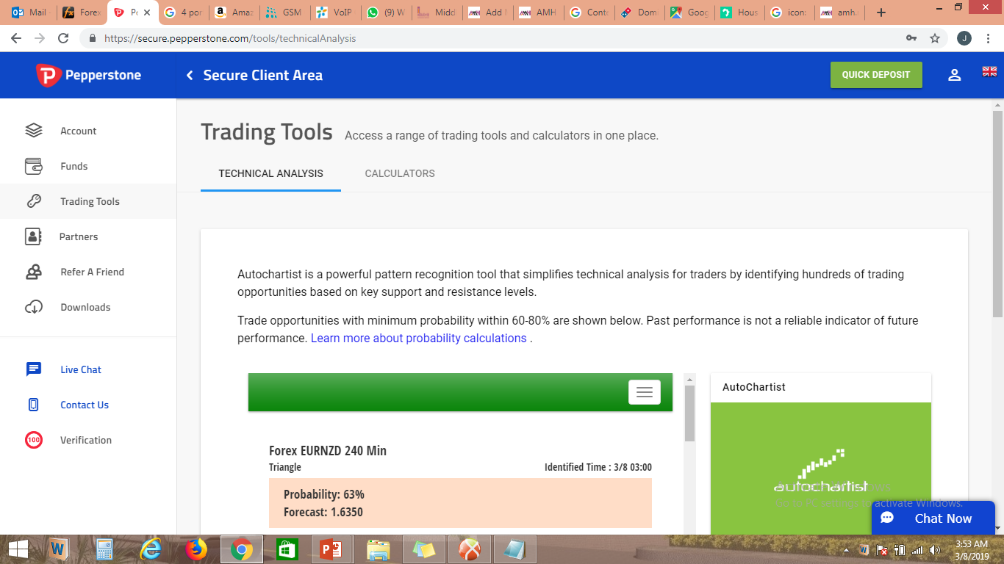

MIDDLECHASE
Claim Your City…
Welcome James Adefuye
My Profile
Log Out
Account
Funds
Refer A Friend
Downloads
Project Updates
Account Manage all your accounts in one place.
Add Property
New Lagos City Estate
FAIRFIELD APARTMENT
New Lagos City Estate
FAIRFIELD APARTMENT
Changes On Mouseover
2 BEDROOM APARTMENT
3 BEDROOM APARTMENT
₦4,000,000.00
BALANCE
13 Apr, 2019
PAYMENT DUE DATE
₦5,000,000.00
BALANCE
10 Jul, 2019
PAYMENT DUE DATE
Live Chat
Contact Us
Verification
₦6,000,000.00
PURCHACE PRICE
₦2,000,000.00
AMOUNT PAID
₦7,500,000.00
PURCHACE PRICE
₦1,750,000.00
AMOUNT PAID
0%
DISCOUNT ALLOWED
13 Mar, 2019
INITIAL PAYMENT DATE
10%
DISCOUNT ALLOWED
10 Jun, 2019
INITIAL PAYMENT DATE
A0138
RESIDENCE NUMBER
12 Sep, 2020
POSSESSION DATE
B0224
RESIDENCE NUMBER
09 Dec, 2020
POSSESSION DATE
Sales Contract
Fund Now
Sales Contract
Fund Now
© 2019 – Middlechase Property LLC A Subsidiary Of Arkbridge Integrated Limited

Slide 3
MIDDLECHASE
Claim Your City…
Welcome James Adefuye
Account
Funds
Refer A Friend
Downloads
Project Updates
Funds Manage all your accounts in one place.
Add Funds History
1
STEP 1
Choose your account
2
STEP 2
Choose your funding method
3
STEP 3
Choose the amount
Live Chat
Contact Us
Verification
New Lagos City Estate
FAIRFIELD APARTMENT
New Lagos City Estate
FAIRFIELD APARTMENT
2 BEDROOM APARTMENT
3 BEDROOM APARTMENT
₦4,000,000.00
BALANCE
A0138
RESIDENCE NUMBER
₦5,000,000.00
BALANCE
B0224
RESIDENCE NUMBER
Fund Now
Fund Now
Back
Continue
© 2019 – Middlechase Property LLC A Subsidiary Of Arkbridge Integrated Limited

Slide 4



MIDDLECHASE
Claim Your City…
Welcome James Adefuye
Account
Funds
Refer A Friend
Downloads
Project Updates
Funds Manage all your accounts in one place.
Add Funds History
STEP 1
2 Bedroom Apartment – A0138
2
STEP 2
Choose your funding method
3
STEP 3
Choose the amount
Live Chat
Contact Us
Verification
24/7
Instant
1
Business Day
Paystack
Bank Transfer
Select Now
Select Now
Back
Continue
© 2019 – Middlechase Property LLC A Subsidiary Of Arkbridge Integrated Limited

Slide 5
MIDDLECHASE
Claim Your City…
Welcome James Adefuye
Account
Funds
Refer A Friend
Downloads
Project Updates
Funds Manage all your accounts in one place.
Add Funds History
STEP 1
2 Bedroom Apartment – A0138
STEP 2
Bank Transfer
3
STEP 3
₦500,000.00
Live Chat
Contact Us
Verification
Amount*
₦500,000.00
Amount Minus Fees
₦500,000.00
Fees
₦0.00
Back
Fund Now
© 2019 – Middlechase Property LLC A Subsidiary Of Arkbridge Integrated Limited

Slide 6
MIDDLECHASE
Claim Your City…
Welcome James Adefuye
Account
Funds
Refer A Friend
Downloads
Project Updates
Refer A Friend Do you want to be rewarded for spreading the good news?
Refer A Friend And You Could Earn!
How would you like to earn extra rewards when you refer your friends and they subscribe to our homes. Take the opportunity to earn up to 10% on your referral transferred to your bank account
Friend History
Live Chat
Contact Us
Verification
First Name
Name |  | Phone | Status | Action
Chudi | Kalu | 08036600600 | Customer | Edit | Delete
Alex | Adefarasin | 08023654015 | Customer | Edit | Delete
James | Adefuye | 08073213366 | Prospect | Edit | Delete
Last Name
Contact Phone
Email
Submit
© 2019 – Middlechase Property LLC A Subsidiary Of Arkbridge Integrated Limited

Slide 7
MIDDLECHASE
Claim Your City…
Welcome James Adefuye
My Profile
Log Out
Account
Funds
Refer A Friend
Downloads
Project Updates
Downloads
Application Form
Middlechase Brochure
Estate Planning Guideline
Frequently Asked Questions
Live Chat
Contact Us
Verification
Download
Download
Download
Download
© 2019 – Middlechase Property LLC A Subsidiary Of Arkbridge Integrated Limited

Slide 8
MIDDLECHASE
Claim Your City…
Welcome James Adefuye
My Profile
Log Out
Account
Funds
Refer A Friend
Downloads
Project Updates
Project Update
Live Chat
Contact Us
Verification
© 2019 – Middlechase Property LLC A Subsidiary Of Arkbridge Integrated Limited

Slide 9


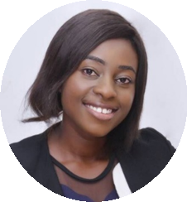
MIDDLECHASE
Claim Your City…
Welcome James Adefuye
My Profile
Log Out
Account
Funds
Refer A Friend
Downloads
Project Updates
Live Chat
Sales Officer
Ayooluwa
Live Chat
Contact Us
Verification
Sales Officer
Oyeyemi
© 2019 – Middlechase Property LLC A Subsidiary Of Arkbridge Integrated Limited

Slide 10
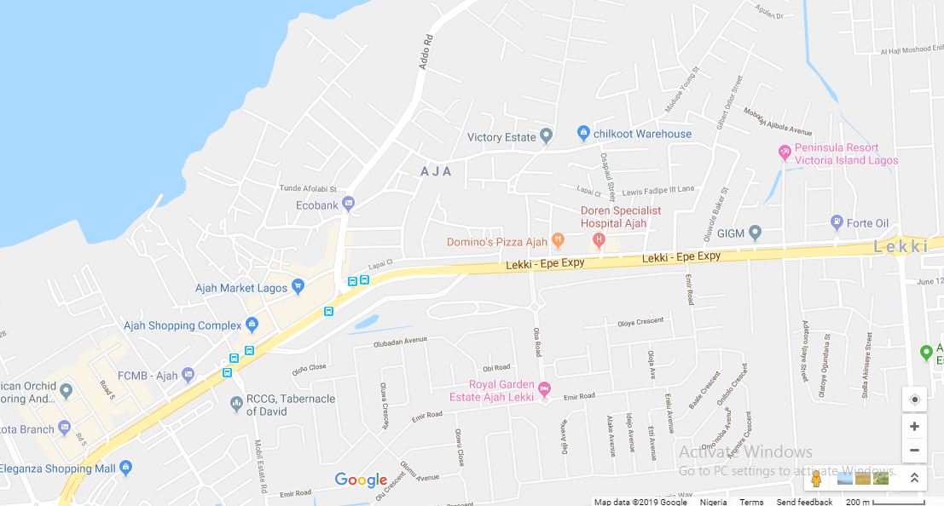
MIDDLECHASE
Claim Your City…
Welcome James Adefuye
My Profile
Log Out
Account
Funds
Refer A Friend
Downloads
Project Updates
Contact Us
Head Office
Head Office
3rd Floor, Viewpoint Plaza,
KM 16, Lekki-Epe Expressway
Along NEPA Road,
Opp. Jubilee Bridge,
Ajah, Lagos State
Email
info@middlechase.com
Phone
0817 873 5450
Live Chat
Contact Us
Verification
© 2019 – Middlechase Property LLC A Subsidiary Of Arkbridge Integrated Limited

Slide 11
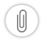
MIDDLECHASE
Claim Your City…
Welcome James Adefuye
Account
Funds
Refer A Friend
Downloads
Project Updates
Verification
PROOF OF IDENTITY WITH A CLEAR PHOTO
Please Select
+
Add Another
Live Chat
Contact Us
Verification
PROOF OF RESIDENCE
Please Select
+
Add Another
To finalise your account application, please send us a CLEAR pictures of your identification document(s).
You may use smartphone, digital camera or scanner to photograph your document(s).
Supported file types (No password protection): JPG, JPEG, PNG, PDF, TIF, GIF, BMP
© 2019 – Middlechase Property LLC A Subsidiary Of Arkbridge Integrated Limited

